Slide 1
Review of Basic Statistics
Advanced Statistics and Analytics

Slide 2
What is Statistics?
The science of planning studies and experiments, obtaining data, and then organizing, summarizing, presenting, analyzing, interpreting, and drawing conclusions based on the data.

Slide 3
Data
Data are the collection of observations such as measurements, genders or survey responses that we want to study.
It is important how we collect the data.

Slide 4
Population and Sample
Population - The complete collection of all measurements or data that are being considered
Census - Collection of data from every member of a population
Sample - Subcollection of members selected from a population
Because populations are very large, we usually want to collect a small amount of data called a sample, that is used to draw conclusions about the entire population.

Slide 5
Example
The Gallup corporation collected data from 1013 adults in the United States. Results showed that 66% of the respondents worried about identity theft.
The population consists of all 241,472,385 adults in the United States.
The sample consists of the 1013 polled adults.
The objective is to use the sample data as a basis for drawing a conclusion about the whole population.

Slide 6
Conducting a Statistical Study
1. Prepare
The first part of the statistical process involves collecting the data. You want to ask questions such as, “What’s the goal of the study?”, “What does the data mean in context with the study?”, “What is the source of the data?”, “How was the data collected?”.

Slide 7
Conducting a Statistical Study
2. Analyze
Next, we want to analyze the data collected using appropriate graphing techniques and other statistical methods.

Slide 8
Conducting a Statistical Study
3. Conclude
Statistical significance is achieved in a study when we get a result that is very unlikely to occur by chance.
State practical implications of the results.
Common sense might suggest that the finding does not make enough of a difference to justify its use or to be practical.

Slide 9
Types of Data
Parameter
a numerical measurement describing some characteristic of a population.
Statistic
a numerical measurement describing some characteristic of a sample.

Slide 10
Types of Data
Quantitative (or numerical) data
consists of numbers representing counts or measurements.
Example: The weights of 4th graders
Example: The ages of respondents

Slide 11
Types of Data
Categorical (or qualitative or attribute) data
consists of names or labels (representing categories).
Example: The gender (male/female) of professional athletes
Example: Shirt numbers on professional athletes uniforms - substitutes for names.

Slide 12
Types of Data
Discrete data: result when the number of possible values is either a finite number or a ‘countable’ number
(i.e. the number of possible values is
0, 1, 2, 3, . . .).
Example: The number of eggs that a hen lays

Slide 13
Types of Data
Continuous (numerical) data
result from infinitely many possible values that correspond to some continuous scale that covers a range of values without gaps, interruptions, or jumps.
Example: The amount of milk that a cow produces; e.g. 2.343115 gallons per day

Slide 14
Types of Data
There are four levels of measurement.
Nominal: the data is classified into categories that cannot be ordered or measured
Example: Gender: Male, Female
Ordinal: the data can be placed into categories that can be ordered or ranked.
Example: Letter Grades: A, B, C, D, F
Interval: data is ranked or arranged in order. The differences between the ordered data can be measured, but there is no true 0 or starting point.
Example: Temperature: The difference between 72
degrees and 73 degrees is 1 degree.
Ratio: data is ranked or arranged in order. The differences between the ordered data can be measured, but there is a true 0 or starting point.
Example: Height, Age, Weight
These measurements cannot be below 0.

Slide 15
Collecting Data
We typically obtain data from two distinct sources: observational studies and experiment.
Observational study observing and measuring specific characteristics without attempting to modify the subjects being studied.
Experiment apply some treatment and then observe its effects on the subjects (subjects in experiments are called experimental units)

Slide 16
Example
The Pew Research Center surveyed 2252 adults and found that 59% of them go online wirelessly.
This an observational study because the adults had no treatment applied to them.

Slide 17
Collecting Data
Simple Random Sample
A sample of n subjects is selected in such a way that every possible sample of the same size n has the same chance of being chosen.
Random Sample
Members from the population are selected in such a way that each individual member in the population has an equal chance of being selected.

Slide 18
Types of Sampling
A random sampling occurs if a sample is drawn in such a way that each time an item is selected, each item has an equal chance of being drawn.
When a sample is obtained by drawing every nth item on a list or production line, the sample is a systematic sample.
A cluster sample is sometimes referred to as an area sample because it is frequently applied on a geographical basis.
Stratified sampling involves dividing the population by characteristics called stratifying factors such as gender, race, religion, or income.
Convenience sampling uses data that are easily or readily obtained, and can be extremely biased.

Slide 19
Types of Studies
In a cross-sectional study, data are observed, measured and collected at one point in time. In a retrospective study, data are collected from the past. In a prospective study, data are collected in the future.

Slide 20
Frequency Distribution
When working with large data sets, it is often helpful to organize and summarize data by constructing a table called a frequency distribution.
A frequency distribution table shows how a data set is partitioned among all of several categories (or classes) by listing all of the categories along with the number (frequency) of data values in each of them.

Slide 21
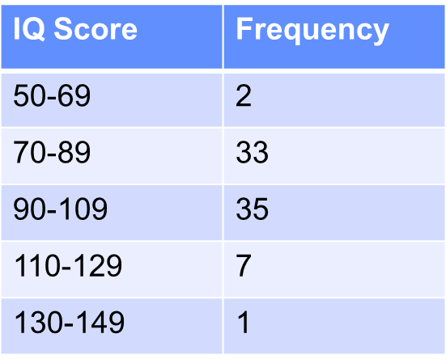
Frequency Distribution Table

Slide 22
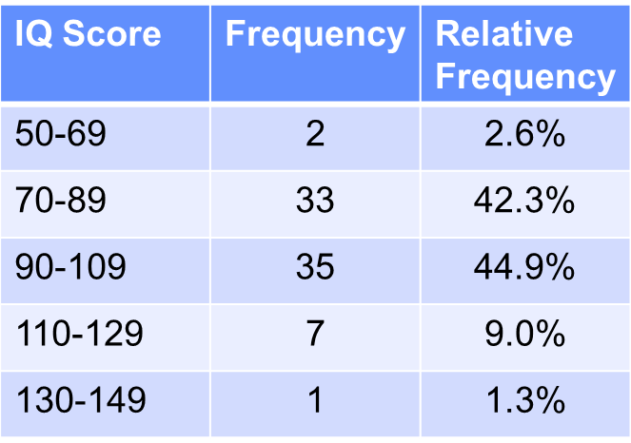
Relative Frequency Distribution table
class frequency
relative frequency =
× 100%
sum of all frequencies

Slide 23
Histograms
A graph consisting of bars of equal width drawn adjacent to each other (unless there are gaps in the data)
The horizontal scale represents the classes of quantitative data values and the vertical scale represents the frequencies.
The heights of the bars correspond to the frequency values.
A histogram is basically a graph of a frequency distribution.

Slide 24
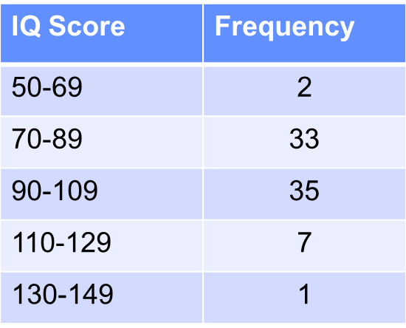
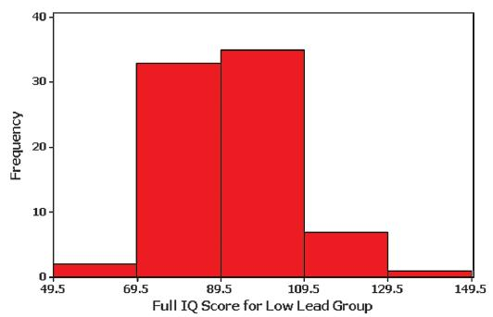
Histogram
IQ scores from children with low levels of lead.

Slide 25
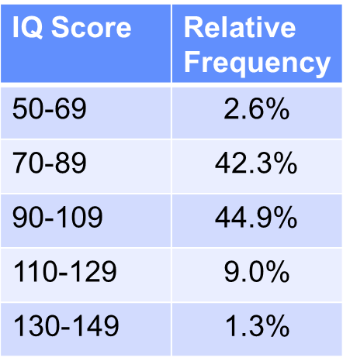
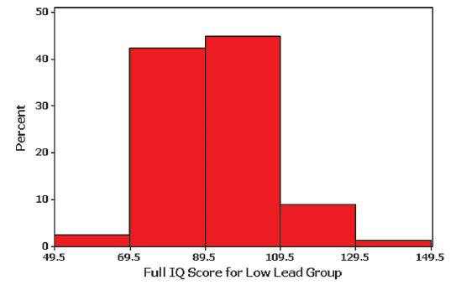
Relative Frequency Histogram
has the same shape and horizontal scale as a histogram, but the vertical scale is marked with relative frequencies instead of actual frequencies

Slide 26
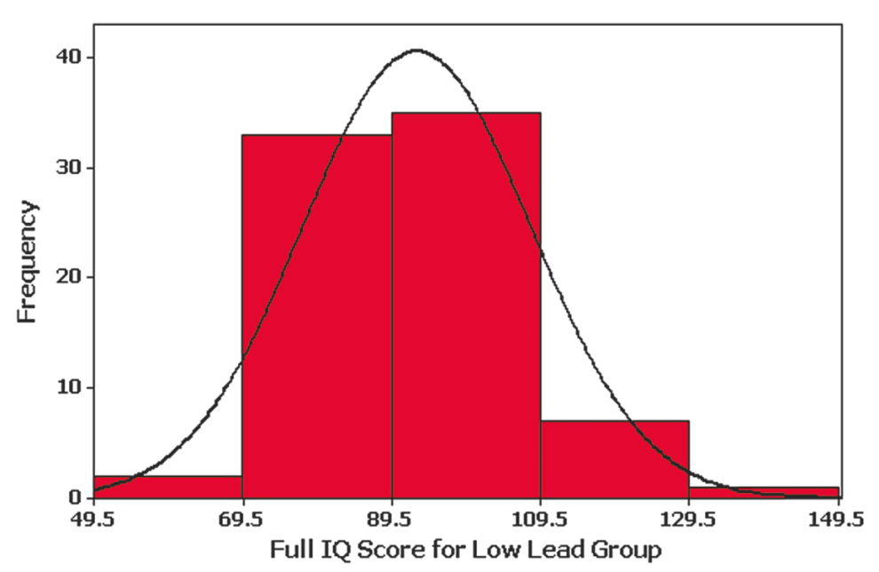
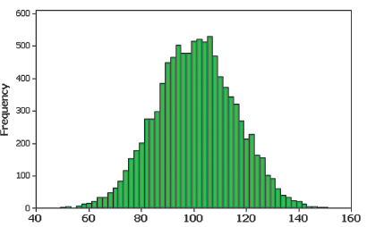
Symmetry

Slide 27
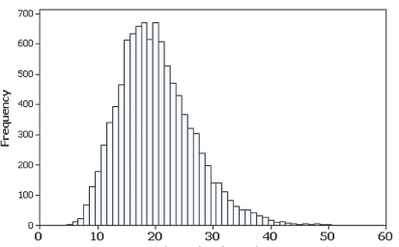
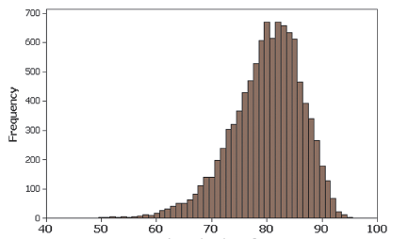
Skewness
A distribution of data is skewed if it is not symmetric and extends more to one side to the other.
Data skewed to the right
(positively skewed) have a longer
right tail.
Data skewed to the left (negative skewed) have a longer left tail.

Slide 28
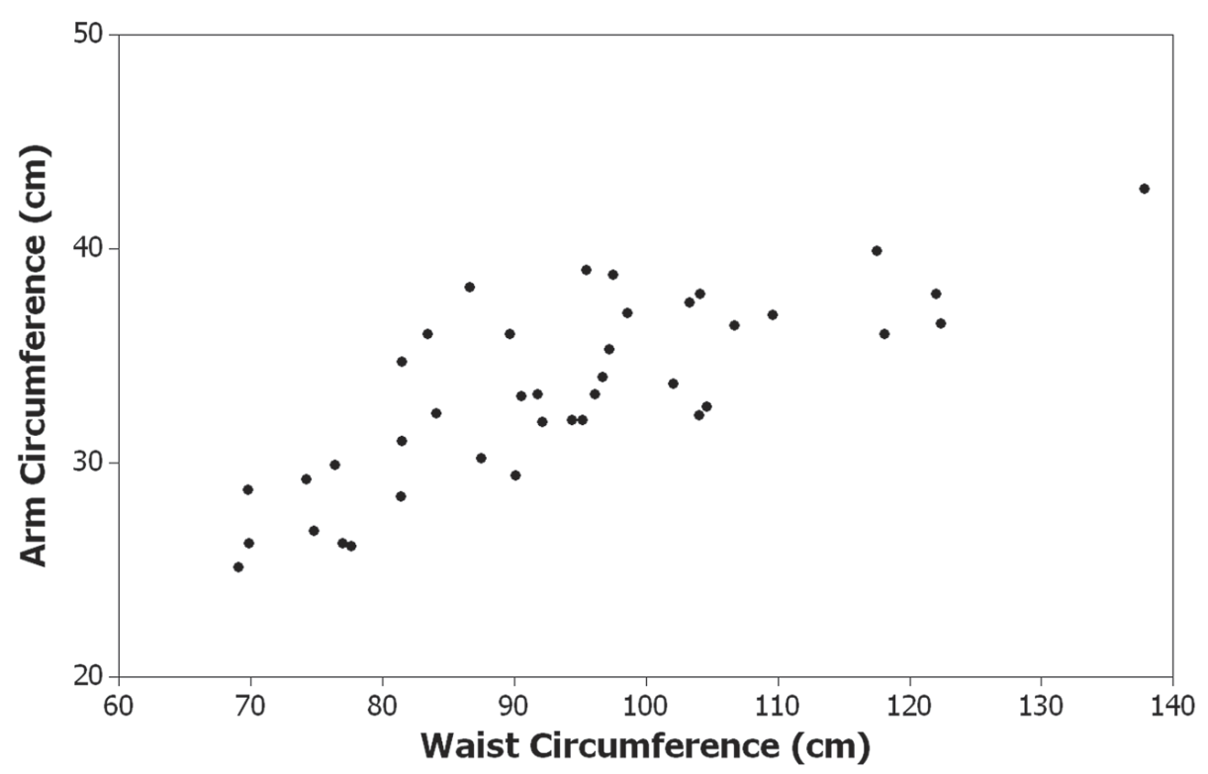
Scatterplot (or Scatter Diagram)
A plot of paired (x, y) quantitative data with a horizontal x-axis and a vertical y-axis. Used to determine whether there is a relationship between the two variables.

Slide 29
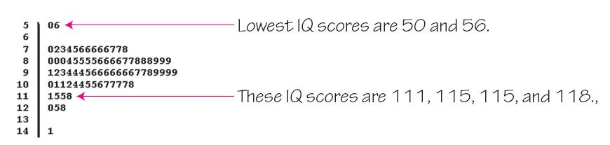
Stemplot (or Stem-and-Leaf Plot)
represents quantitative data by separating each value into two parts: the stem (such as the leftmost digit) and the leaf (such as the rightmost digit).

Slide 30
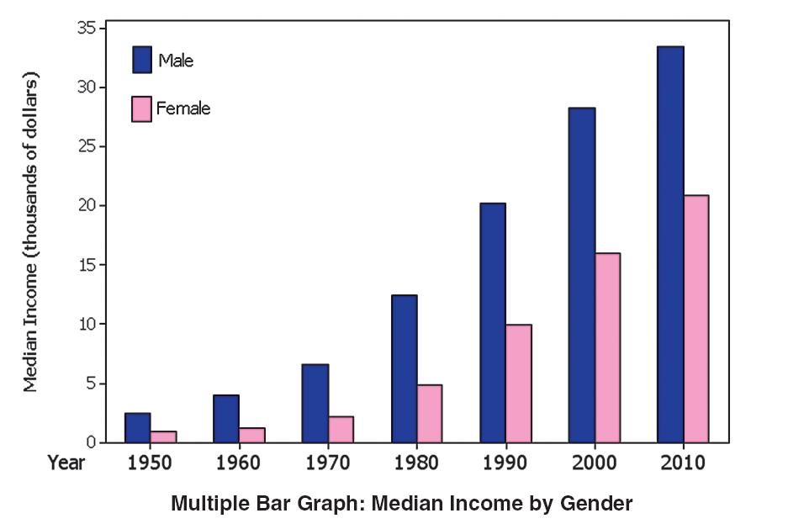
Bar Graph

Slide 31
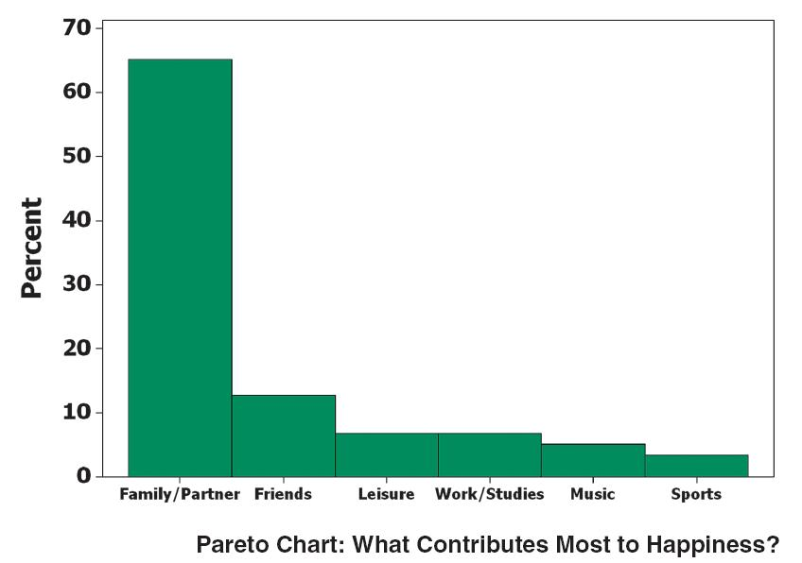
Pareto Chart
A bar graph for qualitative data, with the bars arranged in descending order according to frequencies

Slide 32
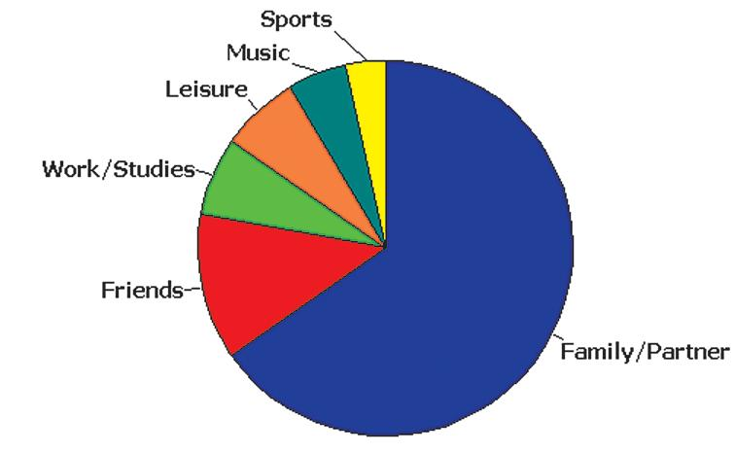
Pie Chart
A graph depicting qualitative data as slices of a circle, in which the size of each slice is proportional to frequency count

Slide 33
Measures of Center
Arithmetic Mean (Mean): the measure of center obtained by adding the values and dividing the total by the number of values. Also called average
Median: the middle value when the original data values are arranged in order of increasing (or decreasing) magnitude
Mode: the value that occurs with the greatest frequency
Midrange: the value midway between the maximum and minimum values in the original data set

Slide 34
Mean

Slide 35
Median
First arrange the values in order). Then –
If the number of data values is odd, the median is the number located in the exact middle of the list.
If the number of data values is even, the median is found by computing the mean of the two middle numbers.

Slide 36
Mode
a. 5.40 1.10 0.42 0.73 0.48 1.10
b. 27 27 27 55 55 55 88 88 99
c. 1 2 3 6 7 8 9 10
Mode is 1.10
Bimodal - 27 & 55
No Mode

Slide 37
Midrange
Midrange =
maximum value + minimum value
2

Slide 38
Mean from a Frequency Distribution

Slide 39
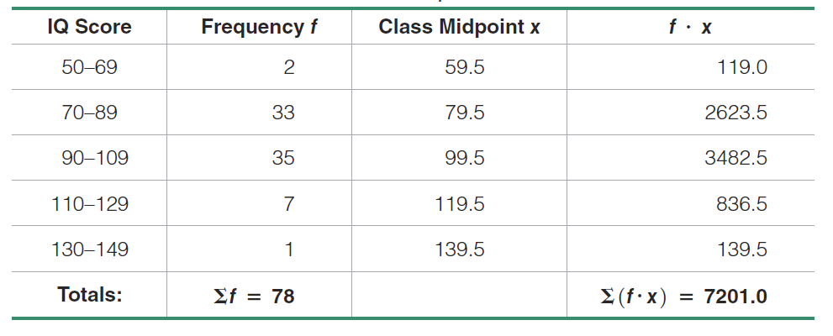
Mean from a Frequency Distribution
Estimate the mean from the IQ scores in Chapter 2.

Slide 40
Probability
This section presents three approaches to finding the probability of an event.
The most important objective of this section is to learn how to interpret probability values.

Slide 41
Events and Sample Space
Event
any collection of results or outcomes of a procedure
Simple Event
an outcome or an event that cannot be further broken down into simpler components
Sample Space
for a procedure consists of all possible simple events; that is, the sample space consists of all outcomes that cannot be broken down any further

Slide 42
Basic Rules for
Computing Probability
Rule 1: Relative Frequency Approximation of Probability
Conduct (or observe) a procedure, and count the number of times event A actually occurs. Based on these actual results, P(A) is approximated as follows:
P(A) =
# of times A occurred
# of times procedure was repeated

Slide 43
Example: Relative Frequency Approximation of Probability
A pond contains 3 types of fish: Blue Gills, Red Gills and Crappies. Each fish in the pond is equally likely to be caught. You catch 120 fish and record the type and release the fish back into the pond. The table below shows your results:
If you were to catch another fish, what is the probability that it will be a Blue Gill?
Using the empirical probability formula, identify the total number of Blue Gills which is your frequency and identify the total frequency.
Therefore, you have a 33% chance of catching a Blue Gill on your next catch.
Fish Type | Number of times caught, f
Blue Gills | 39
Red Gills | 51
Crappies | 30
 | ∑f = 120

Slide 44
Basic Rules for
Computing Probability - continued
Rule 2: Classical Approach to Probability (Requires Equally Likely Outcomes)
Assume that a given procedure has n different simple events and that each of those simple events has an equal chance of occurring. If event A can occur in s of these n ways, then
s
P(A) =
=
number of ways A can occur
n
number of different simple events

Slide 45
Example
A die is rolled. Find the probability of rolling
a) a 2.
b) an odd number.
c) a number less than 4.
d) an 8.
e) a number less than 9.

Slide 46
Solutions: There are six equally likely outcomes: 1, 2, 3, 4, 5, and 6.
a)
b) There are three ways an odd number can occur 1, 3 or 5.
c) Three numbers are less than 4.

Slide 47
Solutions: There are six equally likely outcomes: 1, 2, 3, 4, 5, and 6. continued
d) There are no outcomes that will result in an 8.
e) All outcomes are less than 9. The event must occur and the probability is 1.

Slide 48
Basic Rules for
Computing Probability - continued
Rule 3: Subjective Probabilities
P(A), the probability of event A, is estimated by using knowledge of the relevant circumstances.

Slide 49
Example: Identifying Types of Probability
Classify each statement as classical, empirical or subjective probability.
The probability that you will be married by age 30 is 50%.
This probability is more likely subjective because its an educated guess.
The probability that a voter chosen at random will vote Republican is 45%.
This probability is Empirical because you obtain frequencies of voters to calculate the probability that a voter may vote Republican.
The probability of winning a 1000-ticket raffle with one ticket is 1/1000.
This probability is Classical because you know the number of outcomes and each ticket has an equally likely chance of being selected.

Slide 50
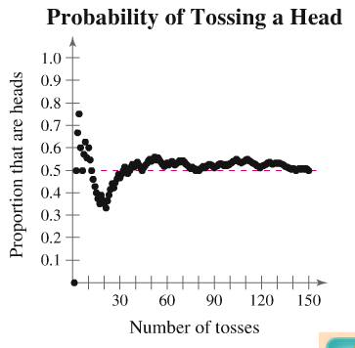
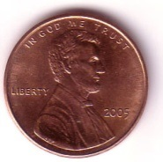
Law of Large Numbers
As an experiment is repeated over and over, the empirical probability of an event approaches the theoretical (actual) probability of the event.

Slide 51
Probability Limits
Always express a probability as a fraction or decimal number between 0 and 1.
The probability of an impossible event is 0.
The probability of an event that is certain to occur is 1.
For any event A, the probability of A is between 0 and 1 inclusive.
That is, 0 ≤ P(A) ≤ 1.

Slide 52
Addition Rule
This section presents the addition rule as a device for finding probabilities that can be expressed as P(A or B).
The probability that either event A occurs or event B occurs (or they both occur) as the single outcome of the procedure.
The key word in this section is “or” It is the inclusive or, which means either one or the other or both.

Slide 53
Mutually Exclusive Events
Mutually exclusive
Two events A and B cannot occur at the same time
A
A
B
B
A and B are mutually
exclusive
A and B are not mutually exclusive
© 2012 Pearson Education, Inc. All rights reserved.
53 of 88

Slide 54
The Addition Rule
Addition rule for the probability of A or B
The probability that events A or B will occur is
P(A or B) = P(A) + P(B) – P(A and B)
For mutually exclusive events A and B, the rule can be simplified to
P(A or B) = P(A) + P(B)
Can be extended to any number of mutually exclusive events
© 2012 Pearson Education, Inc. All rights reserved.
54 of 88

Slide 55
Example: Using the Addition Rule
You select a card from a standard deck. Find the probability that the card is a 4 or an ace.
Solution:
The events are mutually exclusive (if the card is a 4, it cannot be an ace)
Deck of 52 Cards
4♣
4♠
4♥
A♣
4♦
A♠
A♥
A♦
44 other cards
© 2012 Pearson Education, Inc. All rights reserved.
55 of 88

Slide 56
Example: Using the Addition Rule
You roll a die. Find the probability of rolling a number less than 3 or rolling an odd number.
Solution:
The events are not mutually exclusive (1 is an outcome of both events)
Roll a Die
4
6
Odd
Less than three
3
1
1
5
2
© 2012 Pearson Education, Inc. All rights reserved.
56 of 88

Slide 57
Solution: Using the Addition Rule
Roll a Die
4
6
Odd
Less than three
3
1
1
5
2
© 2012 Pearson Education, Inc. All rights reserved.
57 of 88

Slide 58
Independent and Dependent Events
Independent events
The occurrence of one of the events does not affect the probability of the occurrence of the other event
P(B | A) = P(B) or P(A | B) = P(A)
Events that are not independent are dependent
© 2012 Pearson Education, Inc. All rights reserved.
58 of 88

Slide 59
The Multiplication Rule
Multiplication rule for the probability of A and B
The probability that two events A and B will occur in sequence is
P(A and B) = P(A) ∙ P(B | A)
For independent events the rule can be simplified to
P(A and B) = P(A) ∙ P(B)
Can be extended for any number of independent events
© 2012 Pearson Education, Inc. All rights reserved.
59 of 88

Slide 60
Example: Using the Multiplication Rule
Two cards are selected, without replacing the first card, from a standard deck. Find the probability of selecting a king and then selecting a queen.
Solution:
Because the first card is not replaced, the events are dependent.
© 2012 Pearson Education, Inc. All rights reserved.
60 of 88

Slide 61
Example: Using the Multiplication Rule
A coin is tossed and a die is rolled. Find the probability of getting a head and then rolling a 6.
Solution:
The outcome of the coin does not affect the probability of rolling a 6 on the die. These two events are independent.
© 2012 Pearson Education, Inc. All rights reserved.
61 of 88

Slide 62
Binomial Probability Distribution
A binomial probability distribution results from a procedure that meets all the following requirements:
1. The procedure has a fixed number of trials.
2. The trials must be independent.
3. Each trial must have all outcomes classified into two categories: success and failure.
4. The probability of a success remains the same in all trials.

Slide 63
Notation for Binomial Probability Distributions
S and F (success and failure) denote the two possible categories of all outcomes; p and q will denote the probabilities of S and F, respectively, so
(p = probability of success)
(q = probability of failure)

Slide 64
Notation (continued)
n denotes the fixed number of trials.
x denotes a specific number of successes in n trials: 0 ≤ x ≤ n.
p denotes the probability of success in one of the n trials.
q denotes the probability of failure in one of the n trials.
P(x) denotes the probability of getting exactly x successes among the n trials.

Slide 65
Example
When an individual is randomly selected, there is a 0.85 probability that this person knows what Facebook is.
Suppose we want to find the probability that exactly three of five randomly selected individuals knows what Facebook is.
Does this procedure result in a binomial distribution?
Yes. There are five trials which are independent. Each trial has two outcomes (success/failure meaning knows Facebook or doesn’t know Facebook) and there is a constant probability of 0.85 that an individual knows what Facebook is.

Slide 66
The Binomial
Probability Formula
where
n = number of trials
x = number of successes among n trials
p = probability of success in any one trial
q = probability of failure in any one trial (q = 1 – p)

Slide 67
Example
Given there is a 0.85 probability that an individual knows what Facebook is, use the binomial probability formula to find the probability of getting exactly three individuals that know what Facebook is when five adults are randomly selected.
We know:
We need to find:

Slide 68
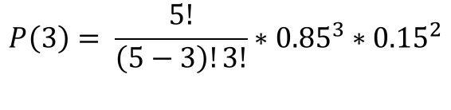

Example
We have:
$$P\left(3\right)= \frac{5!}{\left(5−3\right)!3!}∗{0.85}^{3}∗{0.15}^{2}$$
$$P\left(3\right)=10∗0.614125∗0.0225$$
$$P\left(3\right)=0.138$$

Slide 69
Binomial Distribution: Formulas
Mean
Variance
Std. Dev.
Where
n = number of fixed trials
p = probability of success in one of the n trials
q = probability of failure in one of the n trials

Slide 70
Interpretation of Results
To interpret the results of the mean, variance and standard deviation, we use the range rule of thumb which suggests that values are unusual if they lie outside of these limits:
maximum usual value =
minimum usual value =

Slide 71
Example
Burger King has a 95% recognition rate. 12 individuals are randomly selected to participate in a study of the individuals that recognize the Burger King logo. For such a group, find the mean and standard deviation.

Slide 72
Example - continued
Use the range rule of thumb to find the minimum and maximum usual number of people who would recognize the Burger King logo.
If a particular group of 12 people had all 12 recognize the Burger King logo, that would not be unusual because 12 falls within the 9.8-13 range.

Slide 73
Central Limit Theorem
Characteristics of the Central Limit Theorem:
1. The random variable x has a distribution (which may or may not be normal) with mean μ and standard deviation σ.
2. Simple random samples all of size n are selected from the population. (The samples are selected so that all possible samples of the same size n have the same chance of being selected.)

Slide 74
Central Limit Theorem – cont.
1. The distribution of sample will, as the sample size increases, approach a normal distribution.
2. The mean of the sample means is the population mean .
3. The standard deviation of all sample means is .

Slide 75
Practical Rules Commonly Used
1. For samples of size n larger than 30, the distribution of the sample means can be approximated reasonably well by a normal distribution. The approximation becomes closer to a normal distribution as the sample size n becomes larger.
2. If the original population is normally distributed, then for any sample size n, the sample means will be normally distributed (not just the values of n larger than 30).

Slide 76
Notation
The mean of the sample means
The standard deviation of sample mean
(often called the standard error of the mean)

Slide 77
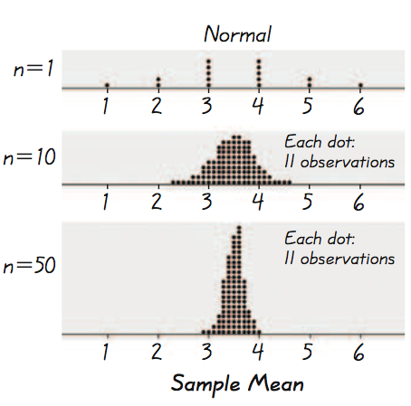
Example - Normal Distribution
As we proceed from n = 1 to n = 50, we see that the distribution of sample means is approaching the shape of a normal distribution.

Slide 78
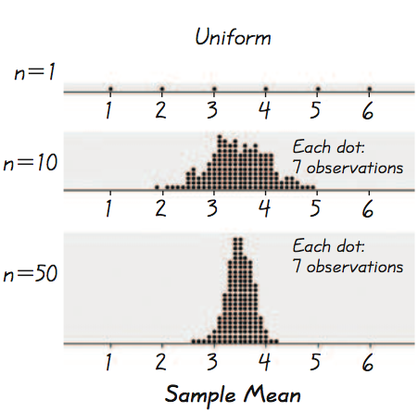
Example - Uniform Distribution
As we proceed from n = 1 to n = 50, we see that the distribution of sample means is approaching the shape of a normal distribution.

Slide 79
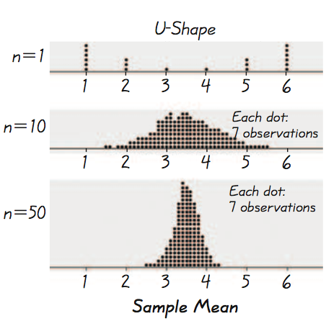
Example - U-Shaped Distribution
As we proceed from n = 1 to n = 50, we see that the distribution of sample means is approaching the shape of a normal distribution.

Slide 80
Important Point
As the sample size increases, the sampling distribution of sample means approaches a normal distribution.
Notes:
Result of example on p 282 of Elementary Statistics, 10th Edition

Slide 81
Suppose a trolley can hold a total of 16 passengers with a total weight of 2500 lb. Assuming a worst case scenario in which the passengers are all male, what are the chances the elevator is overloaded? Assume male weights follow a normal distribution with a mean of 182.9 lb and a standard deviation of 40.8 lb. a. Find the probability that 1 randomly selected male has a weight greater than 156.25 lb. b. Find the probability that a sample of 16 males have a mean weight greater than 156.25 lb (which puts the total weight at 2500 lb, exceeding the maximum capacity).
Example – Elevators

Slide 82
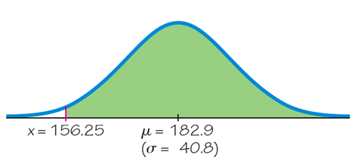
a. Find the probability that 1 randomly selected male has a weight greater than 156.25 lb. Use the methods presented in Section 6.3. We can convert to a z score and use Table A-2. Using Table A-2, the area to the right is 0.7422.
Example – Elevators

Slide 83
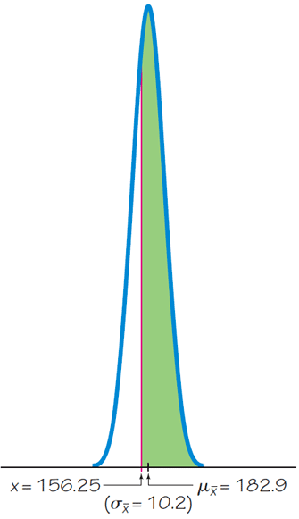
b. Find the probability that a sample of 16 males have a mean weight greater than 156.25 lb. Since the distribution of male weights is assumed to be normal, the sample mean will also be normal. Converting to z:
Example – Elevators

Slide 84
b. Find the probability that a sample of 16 males have a mean weight greater than 156.25 lb. There is a 0.9955 probability that the sample of 16 males will have a mean weight of 156.25 lb or greater. If the trolley is filled to capacity with males, the high probability shows that the 2500 lb. weight limit will be exceeded. Also note that the probability for 1 individual was 74.22% but when we sampled 16 individuals the probability increased to 99.55%.
Example

